Slide 1

MICROSOFT FILMS INVESTMENT – project 1
Deborah Paul​

Slide 2
Outline
Business Problem
Dataset
​Methods
Analysis/Visualisation
Recommendations

Slide 3
Business Problem
Microsoft is exploring potential entry into the film industry by considering investments in film production initiatives. The company is actively engaged in leveraging data-driven insights to enable informed decision-making when it comes to selecting film projects for investment. Microsoft's primary goal is to optimize its return on investment and establish a successful and sustainable presence within the dynamic landscape of the entertainment sector.
In return for their investment, they expect:
- large profit
- reasonable market share
- competitive advantage

Slide 4
Dataset
bom.movie_gross.csv
imdb.title.ratings.csv
imdb.title.basics.csv
tn.movie_budgets.csv

Slide 5
Methods
ETL (extract, transform, and load)
Data has been extracted from different data sources, and cleaned of null values, and duplicates in Python.
Identifying key variables
The important variables used for this analysis are the ‘net profit’ derived from the production budget and worldwide gross revenue, ‘genres’, ‘average rating’, ‘run time in minutes’, and the ‘release date’.
Data analysis and visualizations
The potential investments have been analyzed through graphs in Python, using the key variables.
Recommendations
The investment options based on genre, runtime of movies, and release date have been discussed.

Slide 6
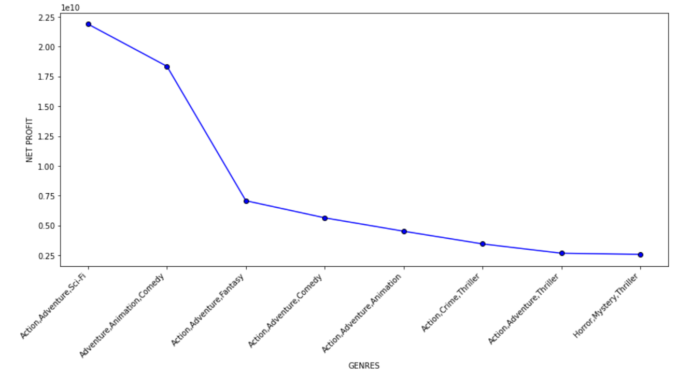
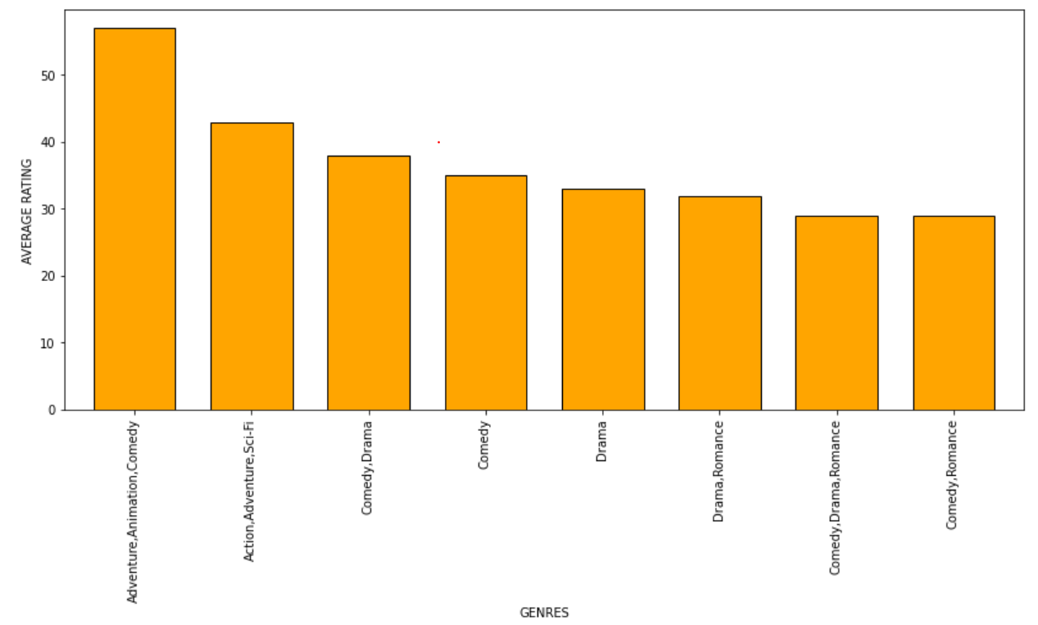
Analysis/visualization
Investment decision based on ‘genre’ which generates high ‘net profit’ and has a good ‘average rating’

Slide 7
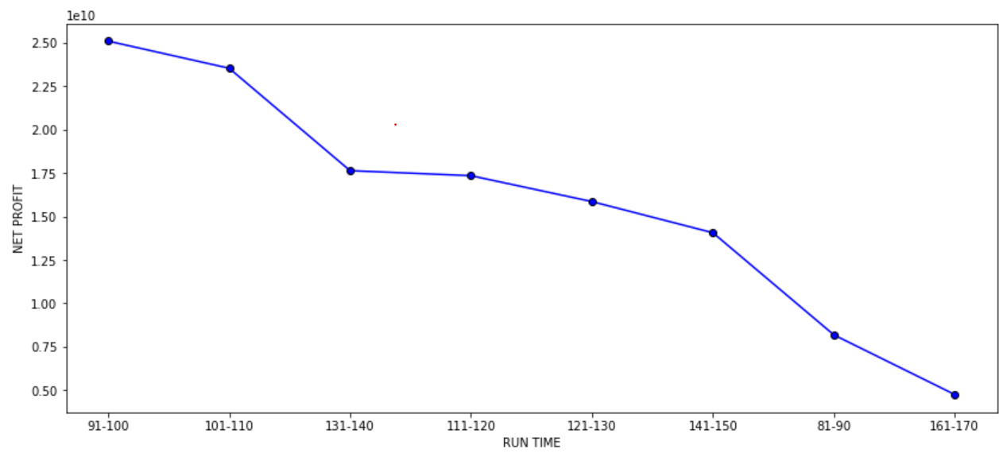
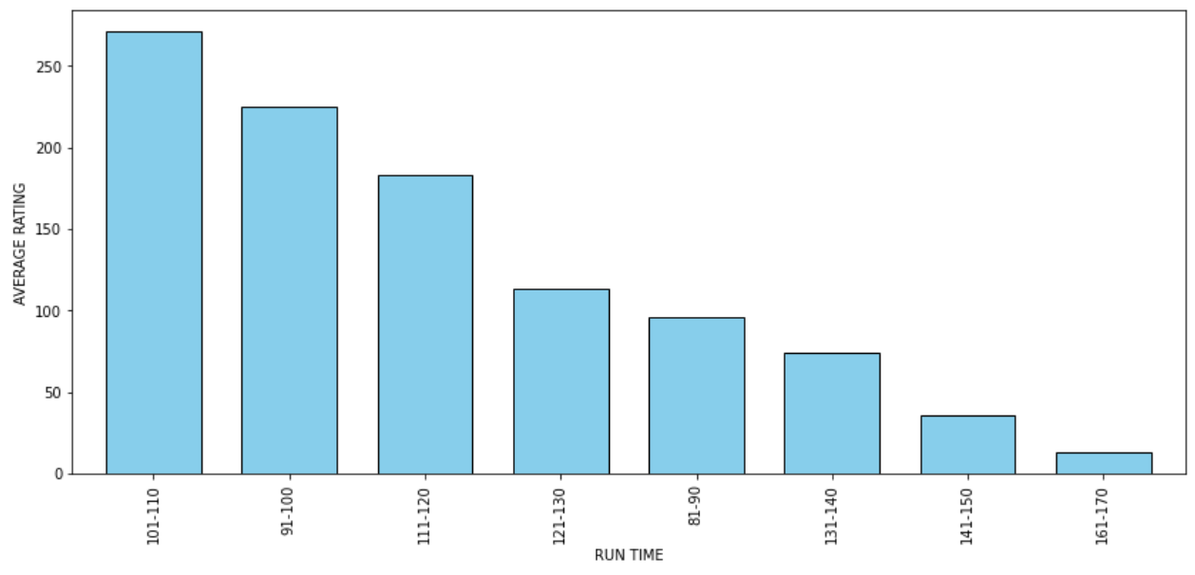
Analysis/visualization (cont’d)
Investment decision based on ‘Run time of movies’ which relates to high ‘net profit’ and has a good ‘average rating’

Slide 8
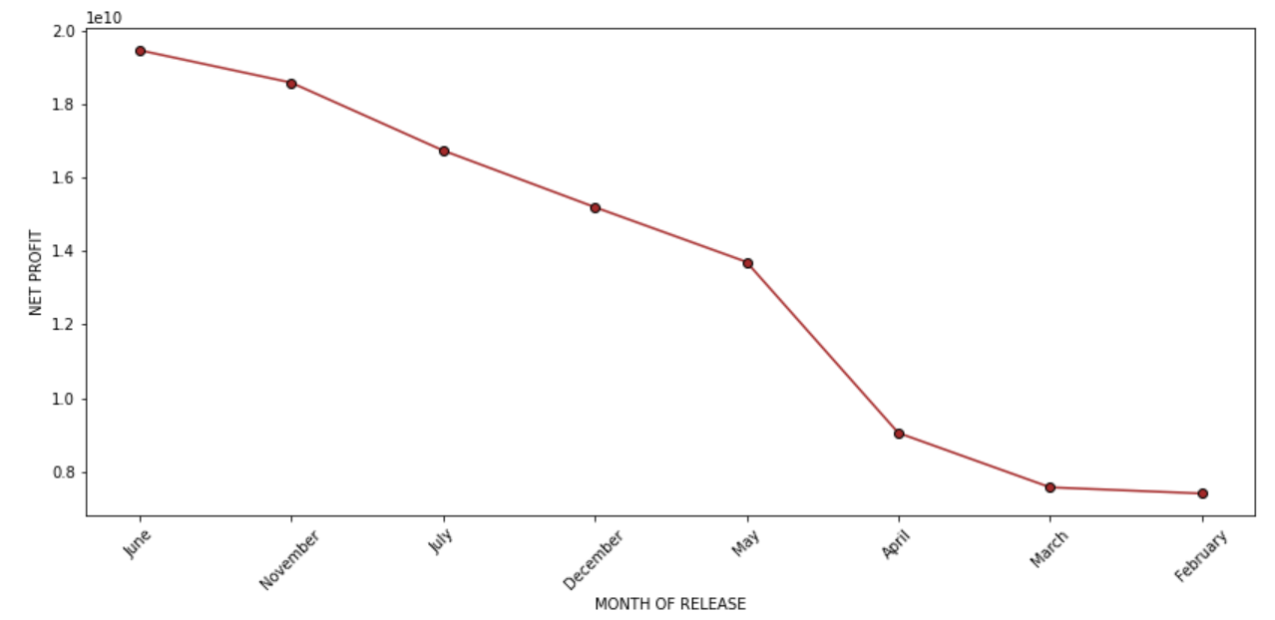
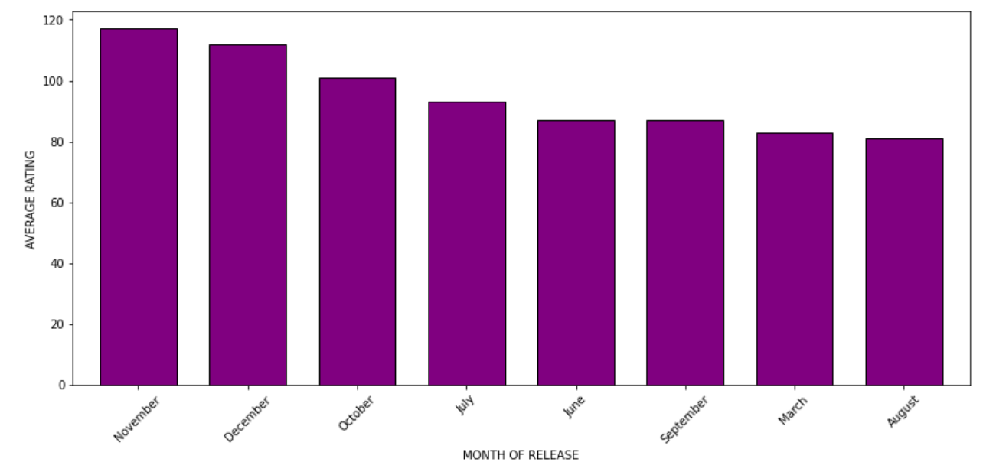
Analysis/visualization (cont’d)
Investment based on ‘Release date’ to generate high ‘net profit’ and a good ‘average rating’

Slide 9
Recommendations
From the graphs, it is obvious that Microsoft should invest in movies that have:
Genres as :
Action, Adventure, and Sci-fi or
Adventure, Animation, and Comedy for high worldwide net profit and excellent ratings from viewers
Runtime as:
90-110 minutes average for high worldwide net profit and a high rating from viewers
Release dates in:
The month of November provides both high margins and better ratings or in June if aimed only at high net profits and a moderate rating from the viewers.

Slide 10
THANK YOU
Deborah Paul
deboj777@gmail.com

